Slide 1

Automation Testing
By- Manas

Slide 2
SELENIUM WEBDRIVER (3.XX)
Working with WebDriver:
For working with webdriver first we need to create an object by importing browser driver class and implement webdriver interface into browser driver by creating reference.
Syntax:
FirefoxDriver f=new FirefoxDriver ();
WebDriver driver=f;
Or
WebDriver driver=new FirefoxDriver ();

Slide 3
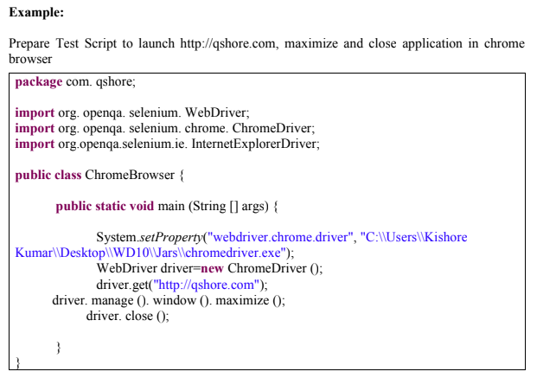

Slide 4
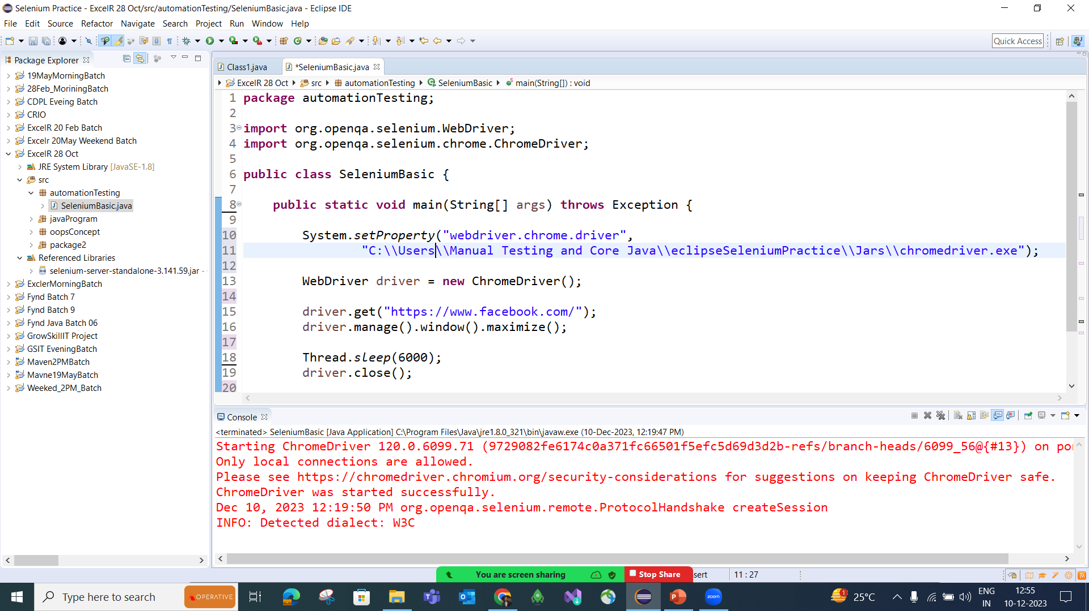

Slide 5
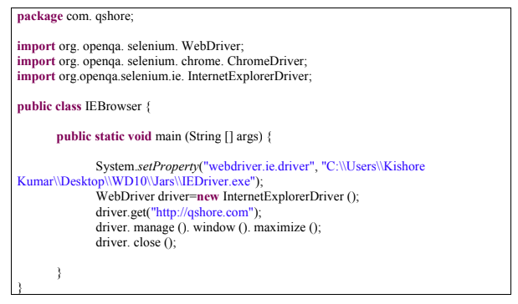
Prepare Test Script to launch http://qshore.com maximize and close application in IE browser

Slide 6
FAQs
What is WebDriver
WebDriver is an interface in Selenium that allows automation of web browsers by directly communicating with browser drivers like ChromeDriver, GeckoDriver, etc
2. How to create WebDriver Reference
WebDriver driver = new ChromeDriver();
3. How to work with Chrome and IE browsers in Webdriver
System.setProperty("webdriver.chrome.driver", "path");
WebDriver driver = new ChromeDriver();
4. What is the Syntax for “System.Setproperty”
System.setProperty("webdriver.chrome.driver", "path_of_driver");
5. How to launch Application using Webdriver
driver.get("https://www.google.com");
6. What is the command used for maximise application
driver.manage().window().maximize();
7. From which package we are importing webDriver
import org.openqa.selenium.WebDriver;
8. How Webdriver different from RC
WebDriver directly communicates with the browser driver, making it faster and more stable compared to Selenium RC, which uses JavaScript injection.
9. What is the latest version of Selenium Server
Selenium 4 is the latest major version

